Slide 1


SOLID principles - {part 1 of 5} "S" the most misunderstood principle
by Martin Chaov

Slide 2

Who is in the
audience?

Slide 3

What is a principle?
SOLID
What is responsibility?
SRP in depth
Summary

Slide 4
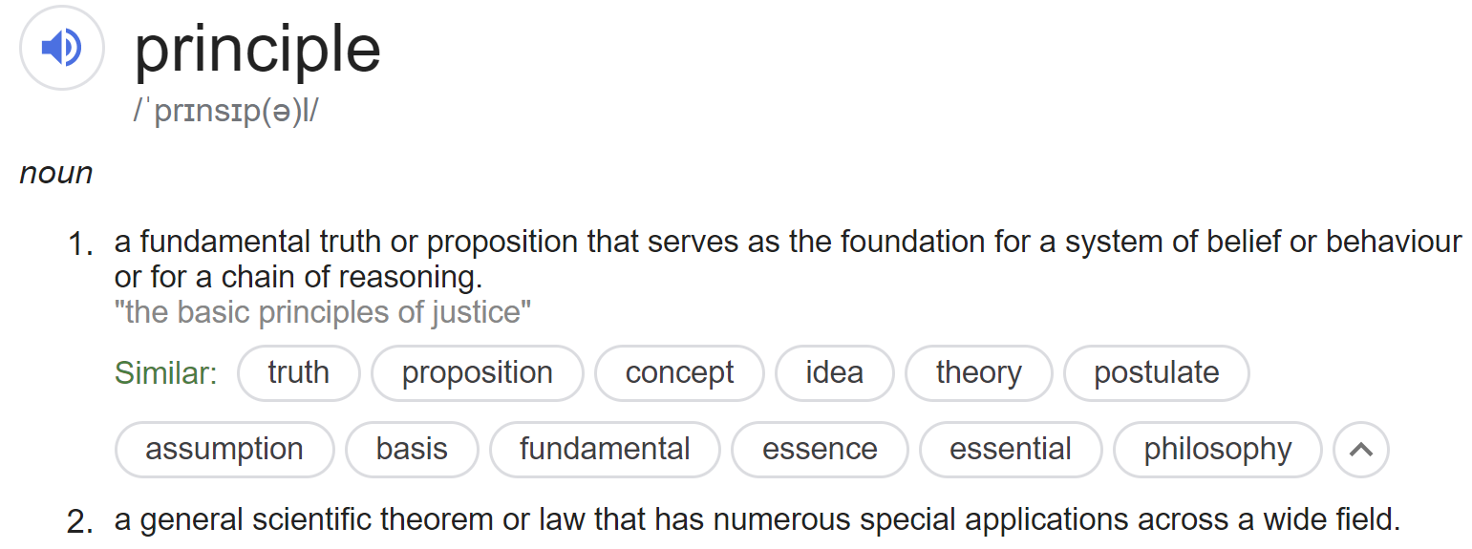
What is a principle?

Slide 5
What are the SOLID principles?
Single Responsibility
Open/Closed
Liskov Substitution
Interface Segregation
Dependency Inversion

Slide 6
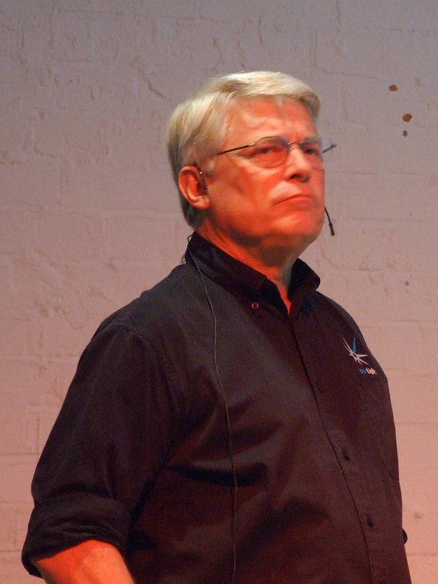


Slide 7
What else about SOLID principles?
They are names for concepts
Heuristic nature
Common sense
Discipline

Slide 8
What the SOLID principles are NOT?
Not rules
Not laws
Not perfect…

Slide 9
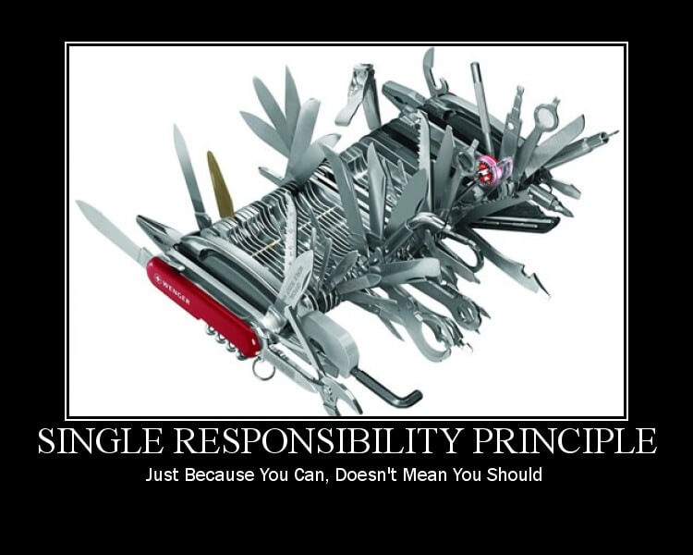
Why focus on SRP?
Most misunderstood of the 5
But why?

Slide 10

What is “responsibility”?

Slide 11
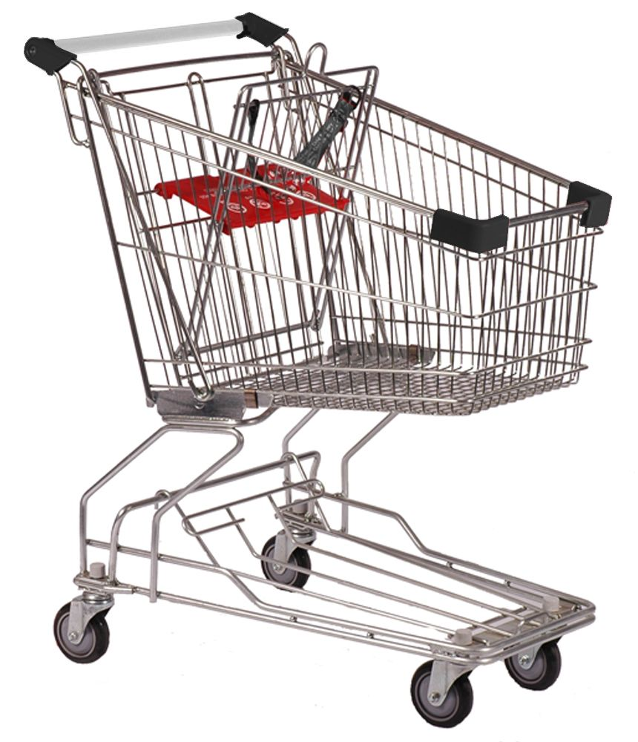

Slide 12
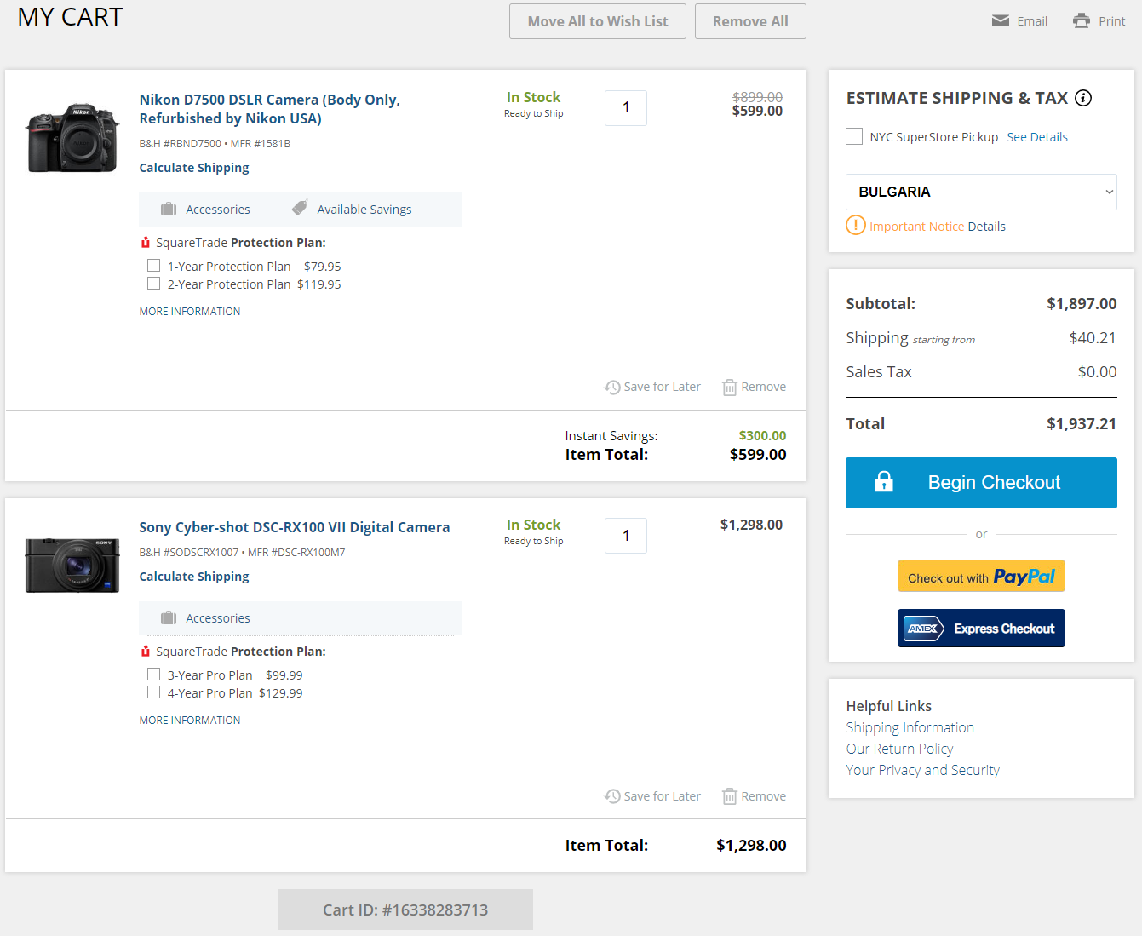

Slide 13
ShoppingCart
+ items
+ subtotal
+ tax
+ total
+ coupon
- taxRules
- orderDetails
- discountsData
+ addItem()
+ addCoupon()
+ placeOrder()
- calculateTax()
- calculatePrice()
- calculateDiscount()

Slide 14

SRP == Cohesion

Slide 15
ShoppingCart
+ items
+ subtotal
+ tax
+ total
+ coupon
- taxRules
- orderDetails
- discountsData
+ addItem()
+ addCoupon()
+ placeOrder()
- calculateTax()
- calculatePrice()
- calculateDiscount()

Slide 16

SRP and Conway’s law
Organizations which design systems ... are constrained to produce designs which are copies of the communication structures of these organizations.

Slide 17
ShoppingCart
+ items
+ subtotal
+ tax
+ total
+ coupon
- taxRules
- orderDetails
- discountsData
+ addItem()
+ addCoupon()
+ placeOrder()
- calculateTax()
- calculatePrice()
- calculateDiscount()

Slide 18

ShoppingCart
+ items
+ subtotal
+ tax
+ total
+ coupon
- taxRules
- orderDetails
- discountsData
+ addItem()
+ addCoupon()
+ placeOrder()
- calculateTax()
- calculatePrice()
- calculateDiscount()

Slide 19

ShoppingCart
+ items
+ subtotal
+ tax
+ total
+ coupon
- taxRules
- orderDetails
- discountsData
+ addItem()
+ addCoupon()
+ placeOrder()
- calculateTax()
- calculatePrice()
- calculateDiscount()

Slide 20
ShoppingCart
+ items
+ subtotal
+ tax
+ total
+ coupon
- taxRules
- orderDetails
- discountsData
+ addItem()
+ addCoupon()
+ placeOrder()
- calculateTax()
- calculatePrice()
- calculateDiscount()

Slide 21

ShoppingCart
+ items
+ subtotal
+ tax
+ total
+ coupon
- taxRules
- orderDetails
- discountsData
+ addItem()
+ addCoupon()
+ placeOrder()
- calculateTax()
- calculatePrice()
- calculateDiscount()

Slide 22
ShoppingCart
+ items
+ subtotal
+ tax
+ total
+ coupon
- taxRules
- orderDetails
- discountsData
+ addItem()
+ addCoupon()
+ placeOrder()
- calculateTax()
- calculatePrice()
- calculateDiscount()

Slide 23
ShoppingCart
+ items
+ subtotal
+ tax
+ total
+ coupon
- taxRules
- orderDetails
- discountsData
+ addItem()
+ addCoupon()
+ placeOrder()
- calculateTax()
- calculatePrice()
- calculateDiscount()

Slide 24
ShoppingCart
+ items
+ subtotal
+ tax
+ total
+ coupon
- taxRules
- orderDetails
- discountsData
+ addItem()
+ addCoupon()
+ placeOrder()
- calculateTax()
- calculatePrice()
- calculateDiscount()

Slide 25
ShoppingCart
+ items
+ subtotal
+ tax
+ total
+ coupon
- taxRules
- orderDetails
- discountsData
+ addItem()
+ addCoupon()
+ placeOrder()
- calculateTax()
- calculatePrice()
- calculateDiscount()

Slide 26
ShoppingCart
+ items
+ subtotal
+ tax
+ total
+ coupon
- taxRules
- orderDetails
- discountsData
+ addItem()
+ addCoupon()
+ placeOrder()
- calculateTax()
- calculatePrice()
- calculateDiscount()

Slide 27
ShoppingCart
PriceCalculator
+ items
+ subtotal
+ tax
+ total
+ coupon
- orderDetails
- taxRules
- discountData
+ calculatePrice()
- calculateTax()
- calculateDiscount()
+ addItem()
+ addCoupon()
+ placeOrder()

Slide 28
ShoppingCartFacade
PriceCalculator
+ items
+ subtotal
+ tax
+ total
+ coupon
- orderDetails
- taxRules
- discountData
+ calculatePrice()
- calculateTax()
- calculateDiscount()
+ addItem()
+ addCoupon()
+ placeOrder()

Slide 29
ShoppingCartFacade
PriceCalculator
+ items
+ subtotal
+ tax
+ total
+ coupon
- orderDetails
- taxRules
- discountData
+ calculatePrice()
- calculateTax()
- calculateDiscount()
+ addItem()
+ addCoupon()
+ placeOrder()

Slide 30
ShoppingCartFacade
PriceCalculator
+ items
+ subtotal
+ tax
+ total
+ coupon
- taxRules
- discountData
+ calculatePrice()
- calculateTax()
- calculateDiscount()
+ addItem()
+ addCoupon()
+ placeOrder()
Cashier
- orderDetails
+ placeOrder()

Slide 31
ShoppingCartFacade
PriceCalculator
+ items
+ subtotal
+ tax
+ total
+ coupon
- taxRules
- discountData
+ calculatePrice()
- calculateTax()
- calculateDiscount()
+ addItem()
+ addCoupon()
+ placeOrder()
Cashier
- orderDetails
+ placeOrder()

Slide 32
PriceCalculator
- taxRules
- discountData
+ calculatePrice()
- calculateTax()
- calculateDiscount()

Slide 33
PriceCalculator
- taxRules
- discountData
+ calculatePrice()
- calculateTax()
- calculateDiscount()

Slide 34
PriceCalculator
Promotions
- taxRules
- discountsData
+ calculatePrice()
- calculateTax()
+ calculateDiscount()

Slide 35
ShoppingCartFacade
Cashier
+ items
+ subtotal
+ tax
+ total
+ coupon
- orderDetails
+ placeOrder()
+ addItem()
+ addCoupon()
+ placeOrder()
PriceCalculator
Promotions
- taxRules
- discountsData
+ calculatePrice()
- calculateTax()
+ calculateDiscount()

Slide 36
<< ICashier >>
+ placeOrder()
<< IPriceCalculator >>
+ calculatePrice()
<< IPromotions >>
+ calculateDiscount()

Slide 37
ShoppingCartFacade
Cashier
+ items
+ subtotal
+ tax
+ total
+ coupon
- orderDetails
+ placeOrder()
+ addItem()
+ addCoupon()
+ placeOrder()
PriceCalculator
Promotions
- taxRules
- discountsData
+ calculatePrice()
- calculateTax()
+ calculateDiscount()

Slide 38
<< ICashier >>
ShoppingCartFacade
+ items
+ subtotal
+ tax
+ total
+ coupon
Cashier
- orderDetails
+ placeOrder()
+ addItem()
+ addCoupon()
+ placeOrder()
PriceCalculator
Promotions
- taxRules
- discountsData
+ calculatePrice()
- calculateTax()
+ calculateDiscount()
<< IPriceCalculator >>
<< IPromotions >>

Slide 39
Presentation
Accounting
Marketing
<<I>>
<<I>>
ShoppingCartFacade
Cashier
Promotions
PriceCalculator

Slide 40
Presentation
Accounting
Marketing
<<I>>
<<I>>
ShoppingCartFacade
Promotions
Cashier
PriceCalculator

Slide 41

SRP vs DRY
Repetition – yes
Coupling – NO!

Slide 42
Presentation
Accounting
Marketing
<<I>>
<<I>>
ShoppingCartFacade
Cashier
Promotions
PriceCalculator
Item
Item
Item

Slide 43
Presentation
Accounting
Marketing
<<I>>
<<I>>
ShoppingCartFacade
Cashier
Promotions
PriceCalculator
Presentation
Item
Asset
Promotional Item

Slide 44
Presentation
Accounting
Marketing
<<I>>
<<I>>
ShoppingCartFacade
Cashier
Promotions
PriceCalculator
Presentation
Item
Asset
Promotional Item

Slide 45
<< ICashier >>
ShoppingCartFacade
+ items
+ subtotal
+ tax
+ total
+ coupon
Cashier
- orderDetails
+ placeOrder()
+ addItem()
+ addCoupon()
+ placeOrder()
PriceCalculator
Promotions
- taxRules
- discountsData
+ calculatePrice()
- calculateTax()
+ calculateDiscount()
<< IPriceCalculator >>
<< IPromotions >>

Slide 46
Summary
Simple hard to follow principle
Responsibility
Evolves over time
Reasons to change are not always under our control
Symptoms

Slide 47

The goal is not to bend developers to the will of some specific patterns, but to get them to think about their work and what they are doing.
Phil Haack

Slide 48


Slide 49

Connect ☺
LinkedIn: https://goo.gl/CRRJ2Y
Mail: martin.c@sbtech.com
Github: https://github.com/mchaov
@raziel_pld

